Slide 1
E-Commerce Analysis
SHOP
Colin Tan G-Hao (U1922153D)
Joshua Toh Sheng Jie (U1921471F)
Tsoi Kin Yi (U1910835C)
Choo Yun Sheng Ryan (U1910399C)
Liu Jia Yang (U1910152C)
Liu Jia Yang

Slide 2
E-Commerce Analysis
PAY
01
Business Problem
02
Measuring Success of Business Outcomes
03
Usage of Analytics
Data Exploration
04
05
Prediction Models
Liu Jia Yang

Slide 3
Introduction
Advancing Technology
B
Shopping online made convenient for all to enjoy
Covid-19
Global lockdown forces stores to close and people to stay at home
A
Consumers have more time to browse online, and are driven (more than ever) to shift to e-commerce
Liu Jia Yang
Notes:
https://beeketing.com/blog/future-ecommerce-2019/#:~:text=New%20studies%20projected%20that%20the,to%20%244.9%20trillion%20in%202021.&text=In%20fact%2C%20by%202021%2C%20it,the%20total%20global%20retail%20sales

Slide 4




Liu Jia Yang

Slide 5
Successful Examples
“The goal is to turn data into information, and information into insights”
One of the BIG FIVE info tech company in US
Dynamic Pricing
Product Recommendations
Biggest online platform for video streaming
Data of viewing habits
Personalised Account
World’s largest coffeehouse chains
Reward programs and mobile applications collect data
Determine branch locations
Liu Jia Yang
Notes:
Dynamic pricing
Everybody knows that airlines use this tactic when selling plane tickets – if you check out the same tickets over and over again, it probably means you really want them and are willing to pay more for them. That same logic is implemented on Amazon’s website. But what you probably didn’t know is that they change their prices up to 2,5 million times a day.
What affects these price changes are factors like shopping patterns, competitor’s prices, and whether the product is a common one or not.
Product recommendations
It doesn’t matter if the person buys the products, puts it in the cart or even just takes a look at it – Amazon will use that data. That way they can learn what each customer wants and likes, and can recommend that same product or similar ones to them when they return to the shop.
This is how the company earns 35% of their annual sales.
Amazon Forecast uses machine learning to combine time series data with additional variables to build forecasts. Amazon Forecast requires no machine learning experience to get started. You only need to provide historical data, plus any additional data that you believe may impact your forecasts.
Netflix is unarguably the biggest online platform for streaming movies and TV shows, and it owes its success to Big Data. Because they know their users, their retention rate is 93% which, compared to their main competitors, is a huge number. They are also growing rapidly because of their original movies and TV shows that just show that they actually listen to their consumers.
The entertainment streaming service has a wealth of data and analytics providing insight into the viewing habits of millions of international consumers.
Netflix uses this data to commission original programming content that appeals globally as well as purchasing the rights to films and series boxsets that they know will perform well with certain audiences.
The way they collect data is by providing their customers with Starbucks rewards programs and mobile apps which help them learn more about the buying habits of each of their customers.
Starbucks is then using that data to recommend products to their loyal customers, create better marketing campaigns and new menus, as well as decide where they’ll open their next store. This system is so organized that it will offer their customers products based on the season, weather and location they are at.
They also send out personalized emails with offers to customers who haven’t visited the store in a while, so they can re-engage them or send them discounts.
Have you ever wondered how Starbucks can open three branches on the same street and not have their business suffer?
The coffeehouse behemoth uses big data to determine the potential success of each new location, taking information on location, traffic, area demographic and customer behaviour into account.
Making this kind of assessment before opening a store means Starbucks can make a fairly accurate estimation of what the success rate will be and choose locations based on the propensity toward revenue growth.

Slide 6

Business Problem
Help E-commerce improve their predictive accuracy in order to increase their sales and also better manage the inventory that they have
Business Problem
Success Indicator of Business Problem
Usage of Analytics
Data Exploration
Prediction Models
Liu Jia Yang

Slide 7




Measuring Success of Business Outcomes
Average Order Value
Sales Conversion Rate
Customer Satisfaction
Customer Lifetime Value
Success Indicator of Business Problem
Business Problems
Usage of Analytics
Data Exploration
Prediction Models
Ryan

Slide 8
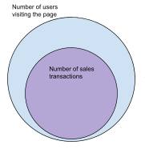
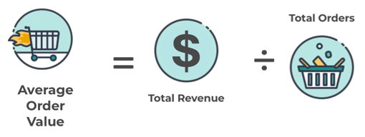
Average Order Value
Sales Conversion Rate
Ryan
Measures how successful the business is in converting their website visitors into paying customers
Measures the average amount of revenue earned per order
Business should think of ways to increase this number
Success Indicator of Business Problem
Business Problems
Usage of Analytics
Data Exploration
Prediction Models
Ryan

Slide 9
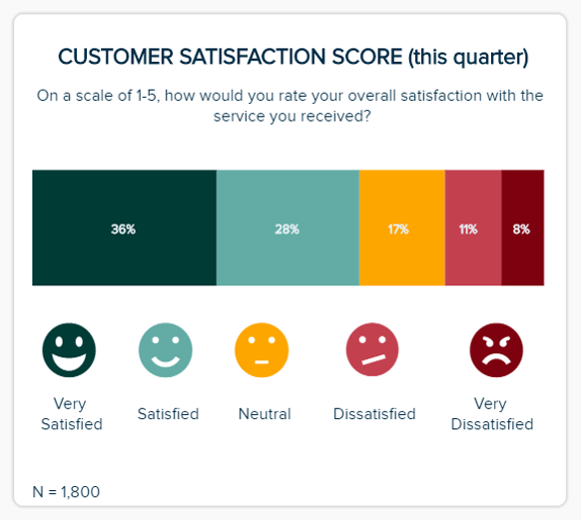
Customer Satisfaction and Returning Rate
Customer Lifetime Value
Measures the total amount of money a customer is expected to spend in the business during their lifetime
Businesses can use this to create loyalty programs or any other ways to retain their customers in the long run
Indicates how satisfied the customers are with the buying experience and products
Success Indicator of Business Problem
Business Problems
Usage of Analytics
Data Exploration
Prediction Models
Ryan

Slide 10



Usage of Analytics in E-Commerce
Improving Inventory Management
Forecasting Purchasing Patterns
Other uses of Analytics
Usage of Analytics
Business Problems
Success Indicator of Business Problem
Data Exploration
Prediction Models
Ryan

Slide 11

Purchasing Patterns and Sales Forecast
Inability to Predict and Identify Customer Purchasing Patterns
Use analytics to sieve out information regarding purchasing patterns
Enables companies to cross-sell and upsell to their customers
Usage of Analytics
Business Problems
Success Indicator of Business Problem
Data Exploration
Prediction Models
Ryan

Slide 12

Improving Inventory Management
Sales and revenue is lost due to the inability to anticipate upcoming demand and sales
Customers look for the best alternative instead
Analytics help to forecast accurately and easily the inventory needed
Usage of Analytics
Business Problems
Success Indicator of Business Problem
Data Exploration
Prediction Models
Ryan

Slide 13
Other Uses of Analytics
Personalised Shopping
Optimize Pricing
Designing Products
Recommending the right products to different individual customers
Analyse pricing trends and determine the optimum price
Maximize the profitability
Track the trends of customers and design products that they
want to buy
SERVICES
Ryan

Slide 14
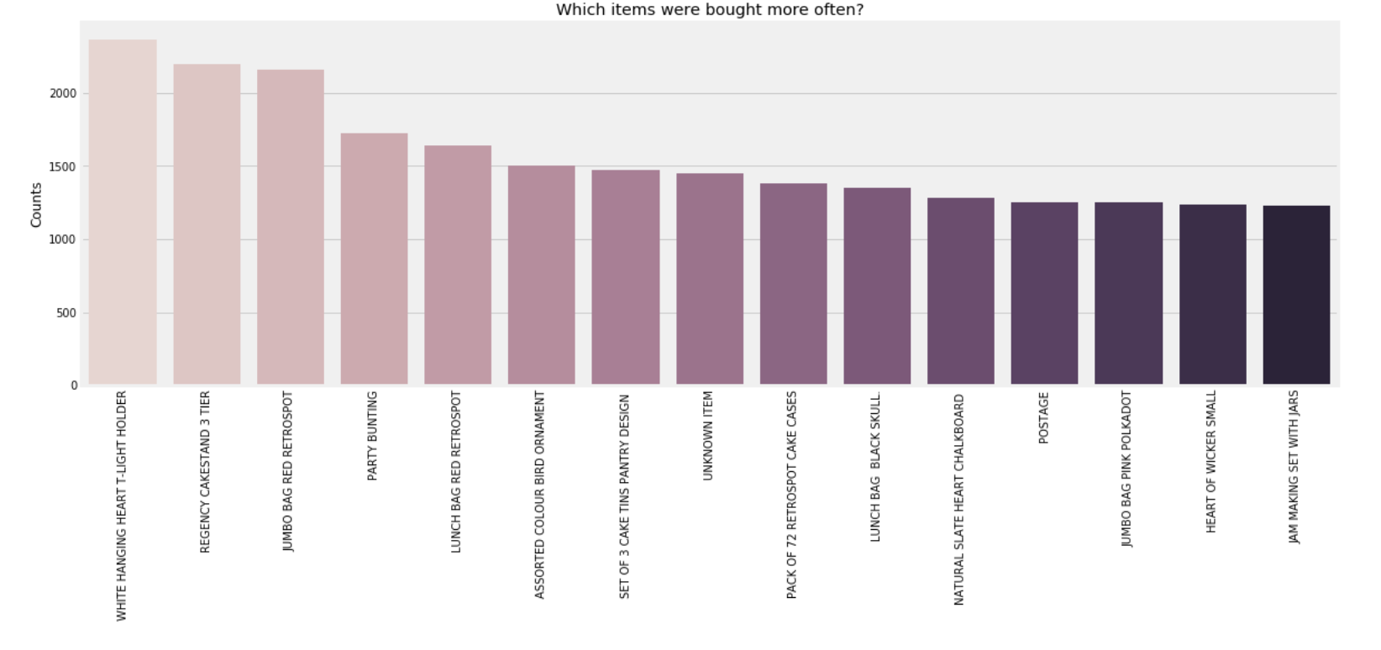
Data Exploration
Data Exploration
Business Problems
Success Indicator of Business Problem
Usage of Analytics
Prediction Models
Kin Yi

Slide 15
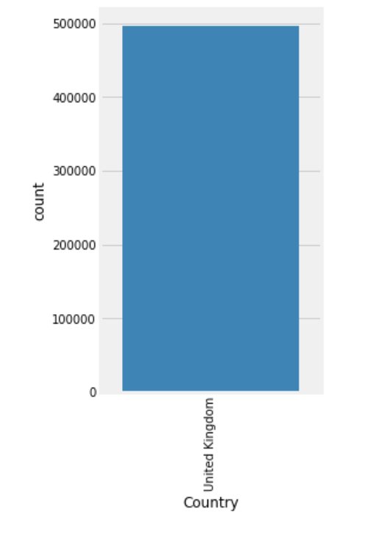
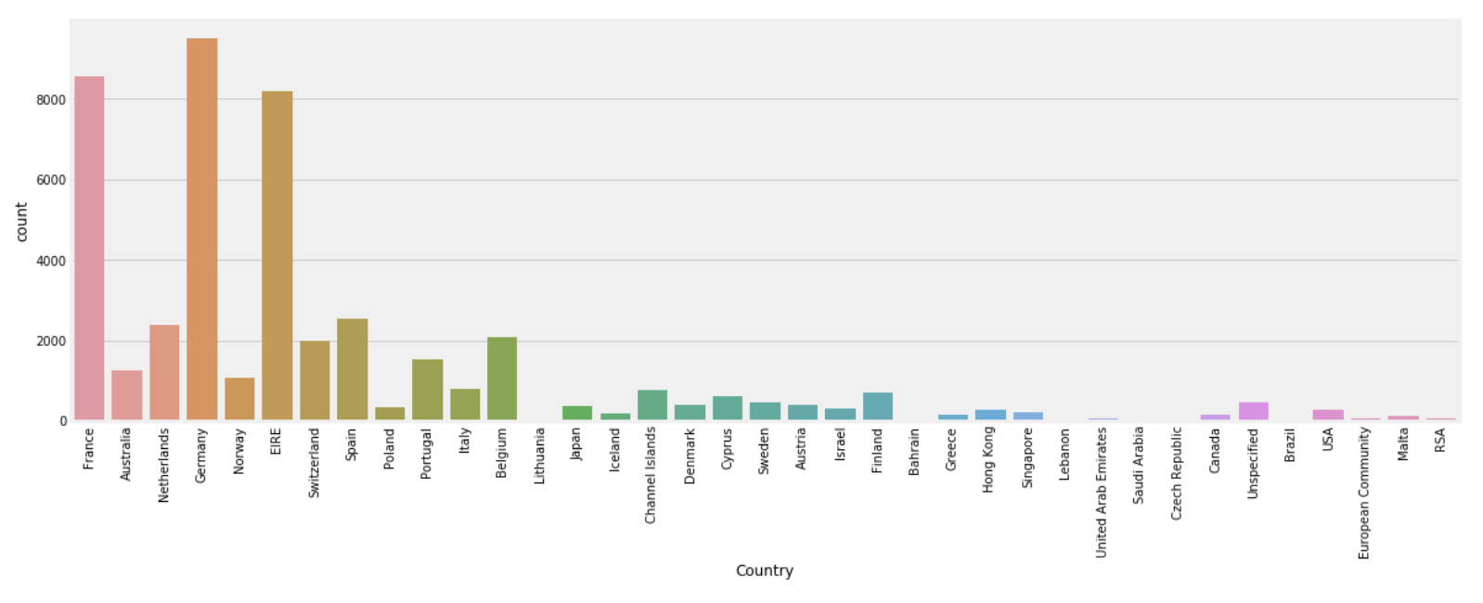
Data Exploration
Main bulk of transactions from United Kingdom at 88.83%
Data Exploration
Business Problems
Success Indicator of Business Problem
Usage of Analytics
Prediction Models
Kin Yi

Slide 16
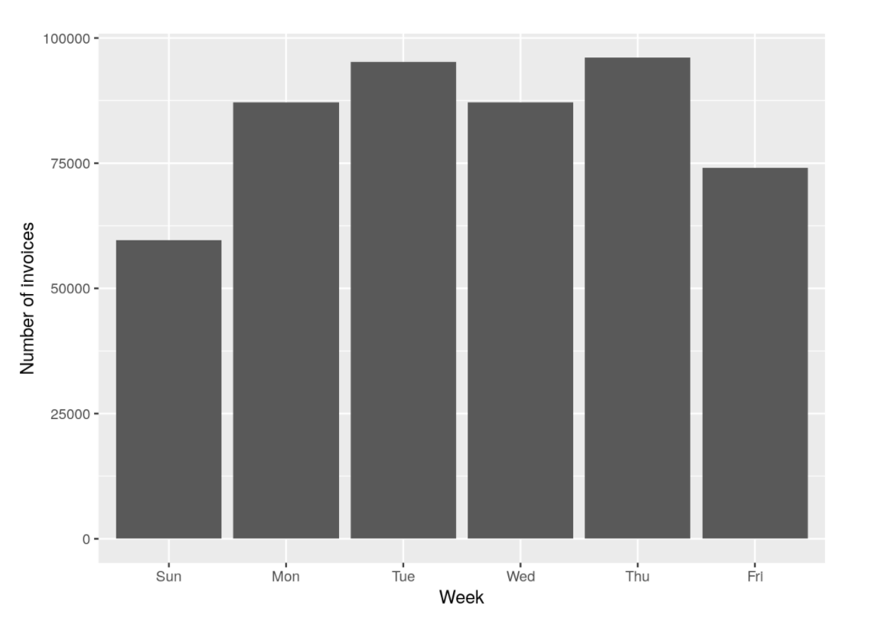
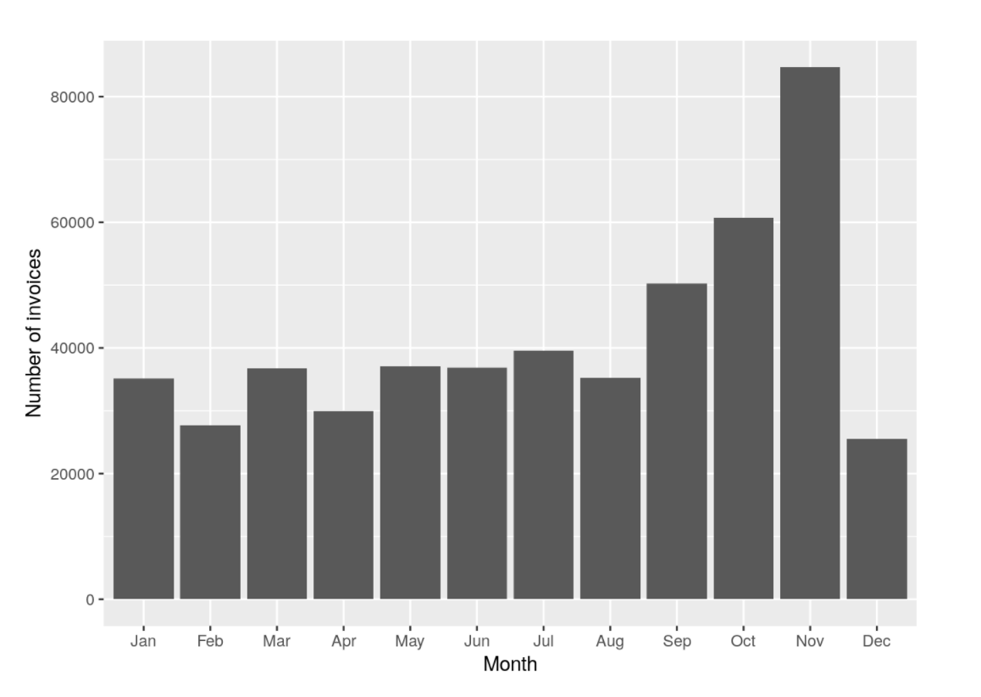
Data Exploration
Data Exploration
Business Problems
Success Indicator of Business Problem
Usage of Analytics
Prediction Models
Kin Yi

Slide 17
PowerBi
Refer to Live Demo
Data Exploration
Business Problems
Success Indicator of Business Problem
Usage of Analytics
Prediction Models
Kin Yi

Slide 18


Techniques Used
Times Series Forecasting
Association Rules
SERVICES
Prediction Models
Business Problems
Success Indicator of Business Problem
Usage of Analytics
Data Exploration
Notes:
Thank you kinyi. Next i will talk about the first technique that our group will be using, which is time series forecasting

Slide 19




Time Series Forecasting
Decomposition
Exponential Smoothing
Time Series Models
Moving Average
ARIMA
Prediction Models
Business Problems
Success Indicator of Business Problem
Usage of Analytics
Data Exploration
Joshua

Slide 20
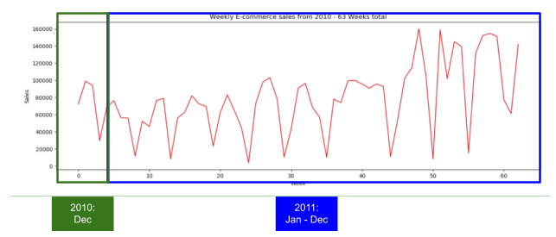
Time Series Forecasting
Y: Sales quantity | X: Time (63 weeks)
Joshua
Notes:
Using 63 weeks worth of data, we can plot a time series shown here. The y axis is the sales quantity, which is what we are interested in.

Slide 21
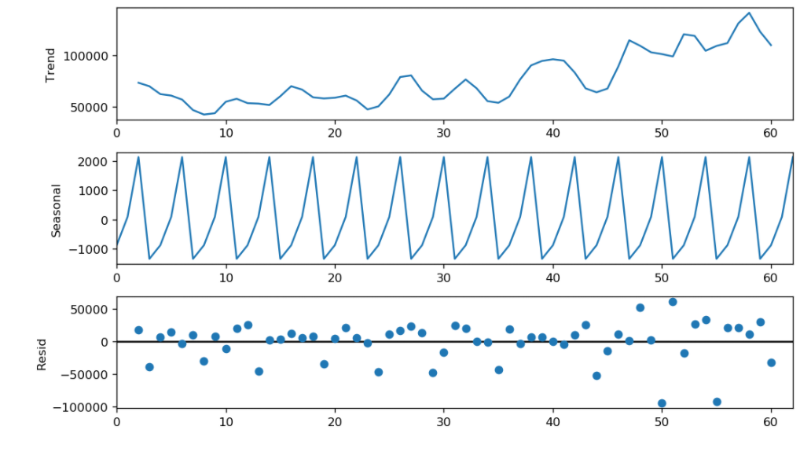
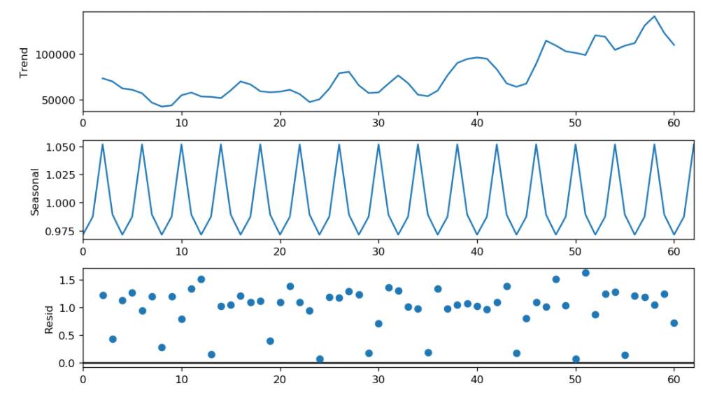
Seasonal Decomposition
Additive series:
Constant fluctuations over time
Multiplicative series:
Changing fluctuations over time
Joshua
Notes:
After running seasonal decomposition with additive and multiplicative settings, we are able to see the plot. Additive series is one with constant fluctuations, while multiplicative series has changing fluctuations over time. The results are similar but we will be using multiplicative.

Slide 22
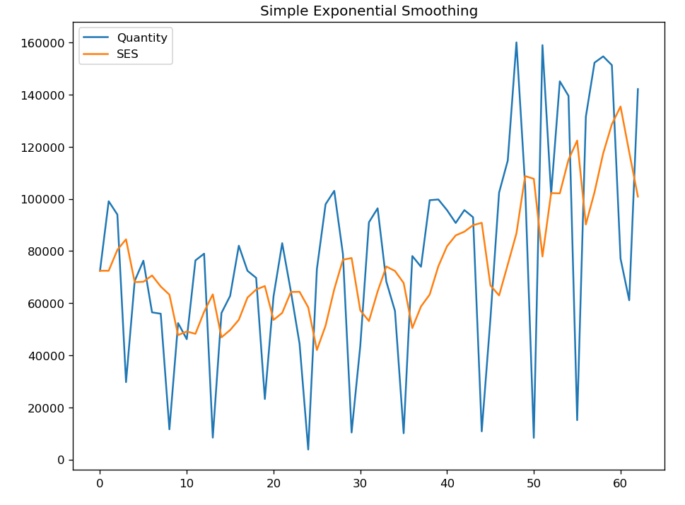
Simple Exponential Smoothing
Uses all the data
Newer data have more priority
Higher α, more weightage on newer data
Limitations:
-Ignore trend & seasonality
Joshua
Notes:
To start off we will be using simple exponential smoothing..

Slide 23
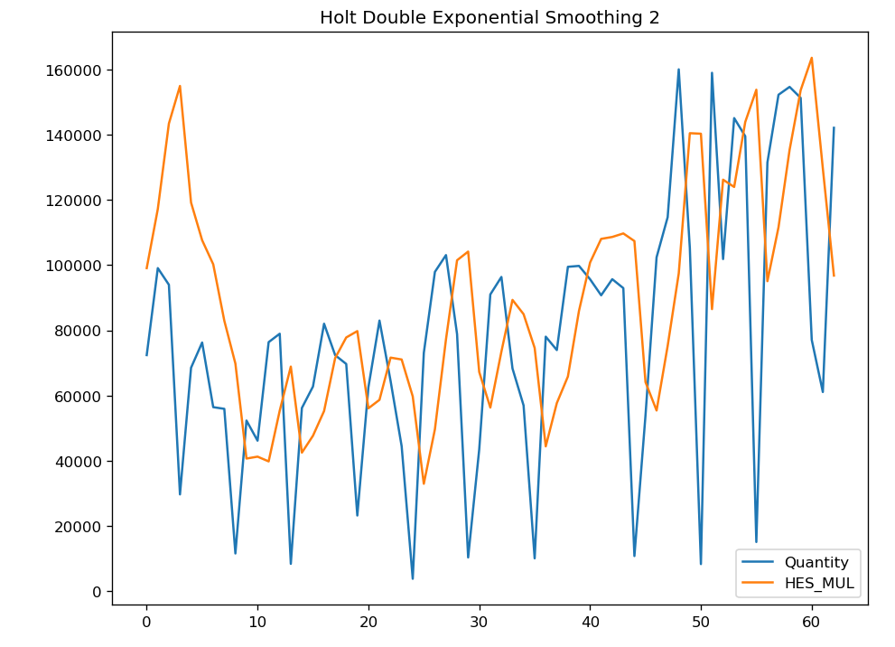
Holt’s method
Extension of exponential smoothing
Takes trend into account
Limitations:
-Ignore seasonality
Joshua
Notes:
To start off we will be using simple exponential smoothing..

Slide 24
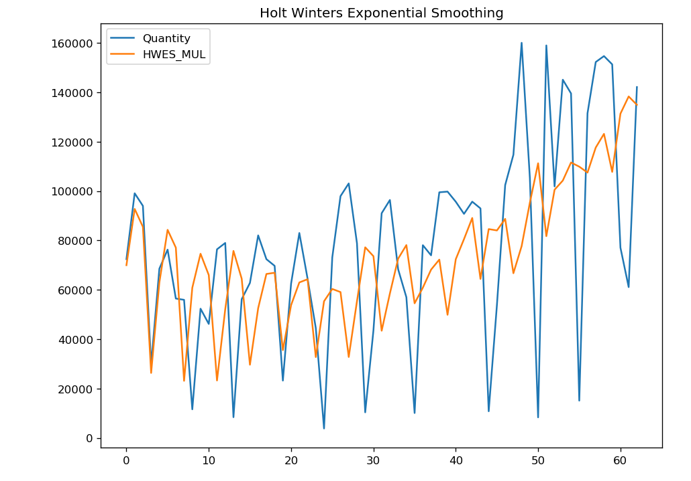
Holt-Winter’s method
Extension of Holt’s method
Takes trend & seasonality
into account
Joshua
Notes:
To start off we will be using simple exponential smoothing..

Slide 25
AutoRegressive Integrated Moving Average
AR: Linear regression, uses its own lag as predictors (p)
Feature | Parameter | Definition
Auto Regressive | p | Linear regression model, uses its own lags as predictors
Integrated | d | Differencing required to make time series stationary
Moving Average | q | Number of lagged forecast error
Joshua
Notes:
To start off we will be using simple exponential smoothing..

Slide 26
Seasonal Auto-ARIMA
Model | AIC
ARIMA(0,0,0)(0,1,0)[4] | 1460
ARIMA(0,0,1)(0,1,1)[4] | 1438
...
ARIMA(3,0,2)(0,1,2)[4] | 1433
Build multiple models with different p,d,q
Uses model with least AIC value
Joshua

Slide 27

Akaike Information Criteria (AIC)
Score to determine the best model
Valuable for time series, because time series analysis’ most valuable data is often the most recent
Joshua
Notes:
AIC is a single number score that can be used to determine which of multiple models is most likely to be the best model for a given dataset. It estimates models relatively, meaning that AIC scores are only useful in comparison with other AIC scores for the same dataset. A lower AIC score is better.
AIC is particularly valuable for time series, because time series analysis’ most valuable data is often the most recent, which is stuck in the validation and test sets.

Slide 28
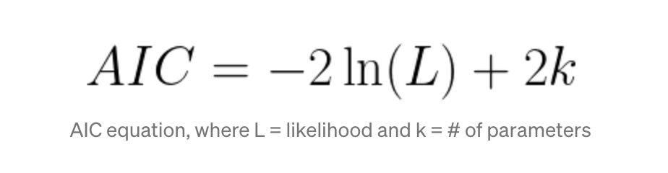
How it works (AIC)
Evaluates the model’s fit on the training data, and adds a penalty term for the complexity of the model
AIC uses a model’s maximum likelihood estimation (log-likelihood) as a measure of fit
The desired result is to find the lowest possible AIC
Joshua
Notes:
Log-likelihood is a measure of how likely one is to see their observed data, given a model. The model with the maximum likelihood is the one that “fits” the data the best. The natural log of the likelihood is used as a computational convenience. F
AIC is particularly valuable for time series, because time series analysis’ most valuable data is often the most recent, which is stuck in the validation and test sets.

Slide 29
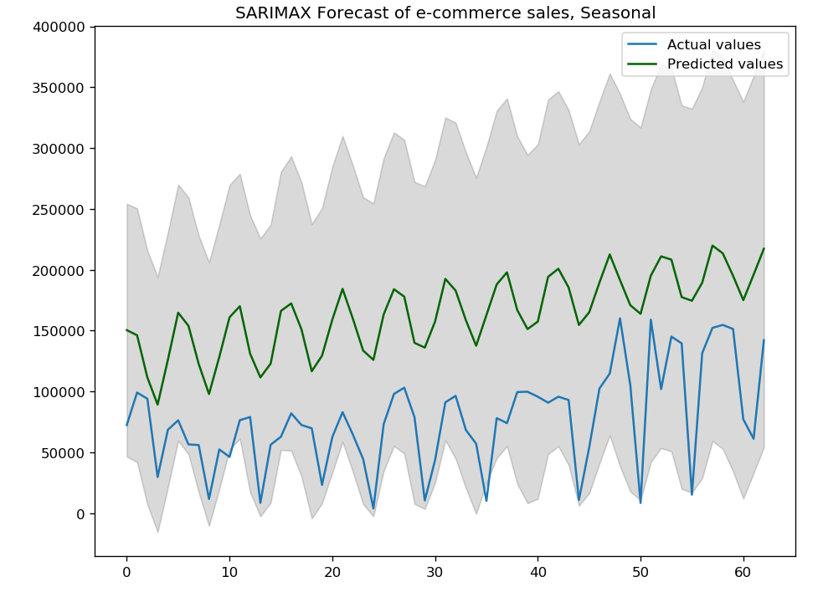
Seasonal Auto-ARIMA
Joshua

Slide 30
Model evaluation
 | AIC | RMSE | MAE
Simple Exponential Smoothing | 1336 | 39239 | 30250
Holt’s method | 1334 | 37172 | 29498
Holt-Winter’s method | 1347 | 38669 | 31005
Non-seasonal ARIMA | 1512 | 40438 | 31794
Seasonal ARIMA | 1431 | 91621 | 86477
Joshua

Slide 31
Association Rules
Anticipate customer purchases and recommend products → improve sales
03
Finding association between sets of items
Determine probability of various combinations of products purchased
01
02
Prediction Models
Business Problems
Success Indicator of Business Problem
Usage of Analytics
Data Exploration
Colin

Slide 32
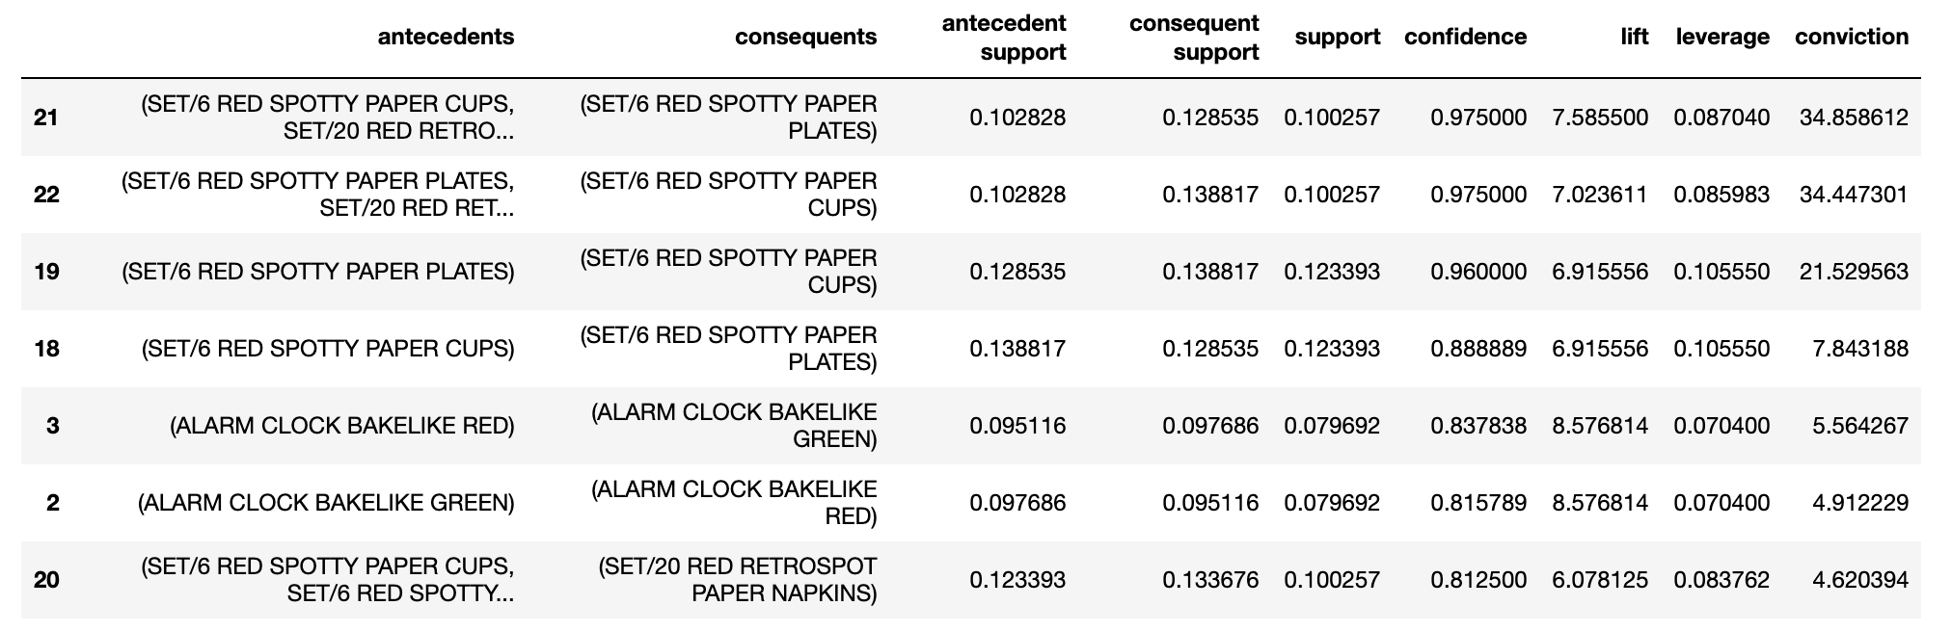
Association Rules
Prediction Models
Business Problems
Success Indicator of Business Problem
Usage of Analytics
Data Exploration
Colin

Slide 33
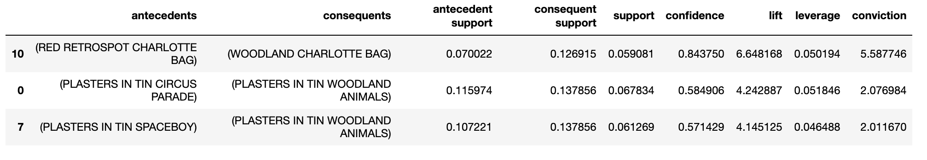
Association Rules
Prediction Models
Business Problems
Success Indicator of Business Problem
Usage of Analytics
Data Exploration
Colin

Slide 34
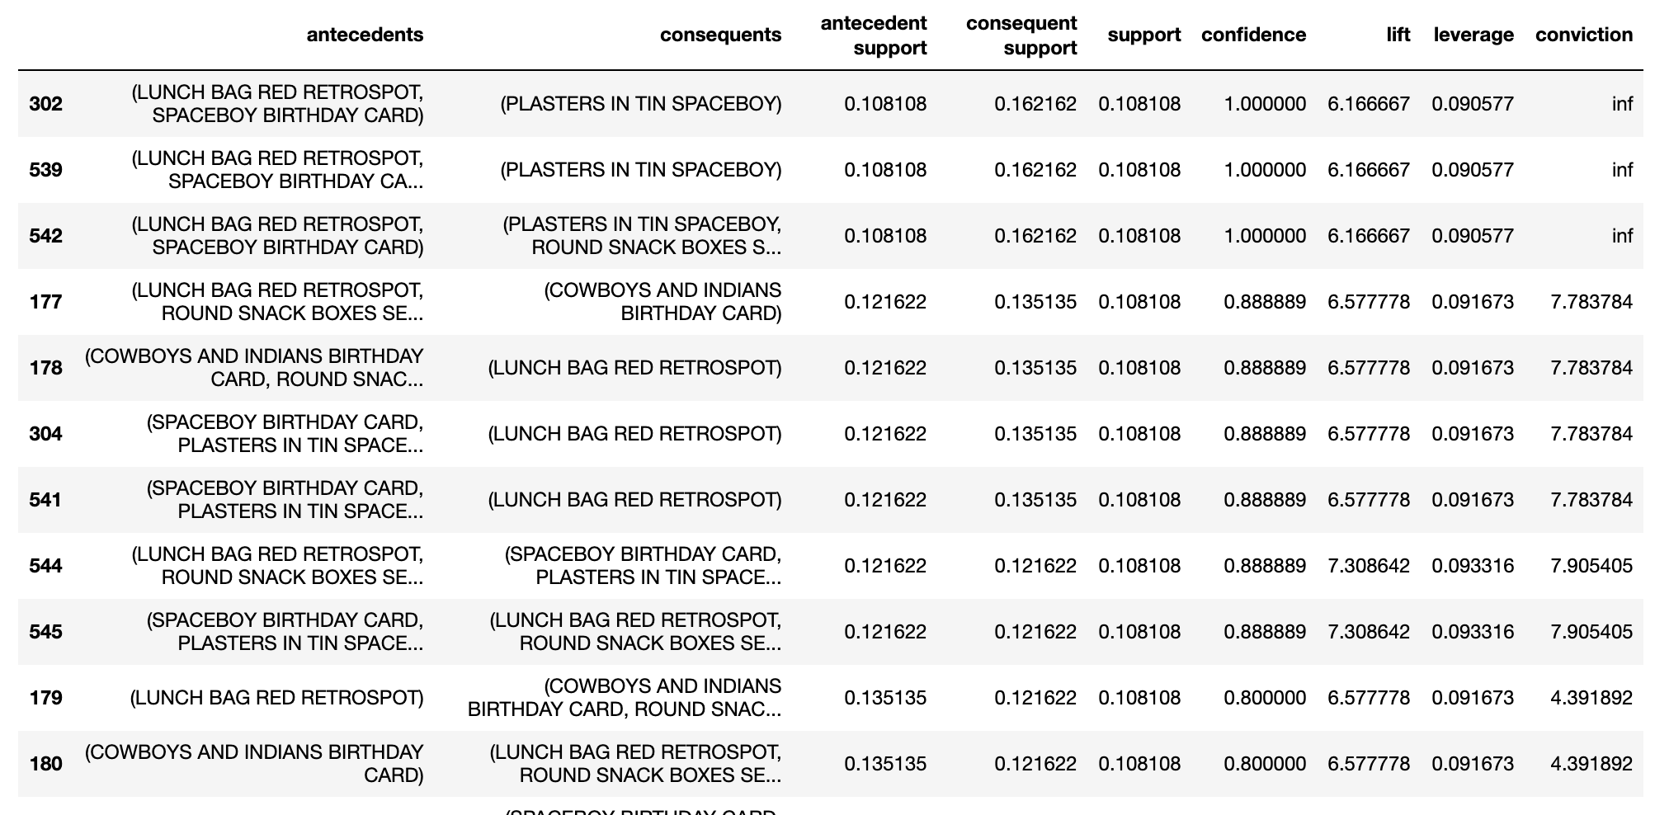
Association Rules
Prediction Models
Business Problems
Success Indicator of Business Problem
Usage of Analytics
Data Exploration
Colin

